Slide 1
Dynamic Programming
Riry & André

Slide 2
The 3 tasks
Inventory planning
Packing products
Delivery planning

Slide 3

Inventory Planning
Determine the minimum capacity needed to store all of the supplies before they are shipped.

Slide 4
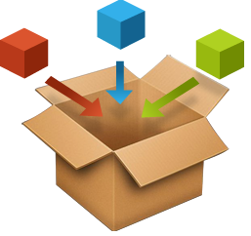
Packing products
Pack a single container as densely as possible or pack all objects using as fell containers as possible.

Slide 5
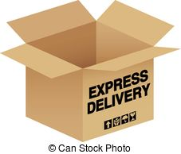
Delivery planning
Find the optimal set of rules in order to delivery to a given set of customers.

Slide 6
DP to all problems? Are you sure?
Inventory Planning
( ??? )
Packing Products
( knapsack problem )
Delivery Planning
( shortest path problem )

Slide 7
About Dynamic Programming
Is a way to solve a complex problem by breaking it down into a collection of simpler sub-problems
Optimal substructure and overlapping sub-problems
Top-down and bottom-up approaches
Dynamic timeline…

Slide 8
Let’s solve one of them today
Xxxxx…
(many slides to explain it)

Slide 9
Other algorithms
Can other algorithms solve the same problems?
Why use DP for these cases?
Xxxxx…

Slide 10
Thanks!

